Slide 1
Topology Optimization
John Moczygemba

Slide 2
Problem
Oftentimes parts are modeled without their geometry being optimized. Ribs are sometimes placed in places where it is guessed that stresses will be greatest
In this example, an oil pan is analyzed
Ribs are removed and then a topography optimization is performed

Slide 3
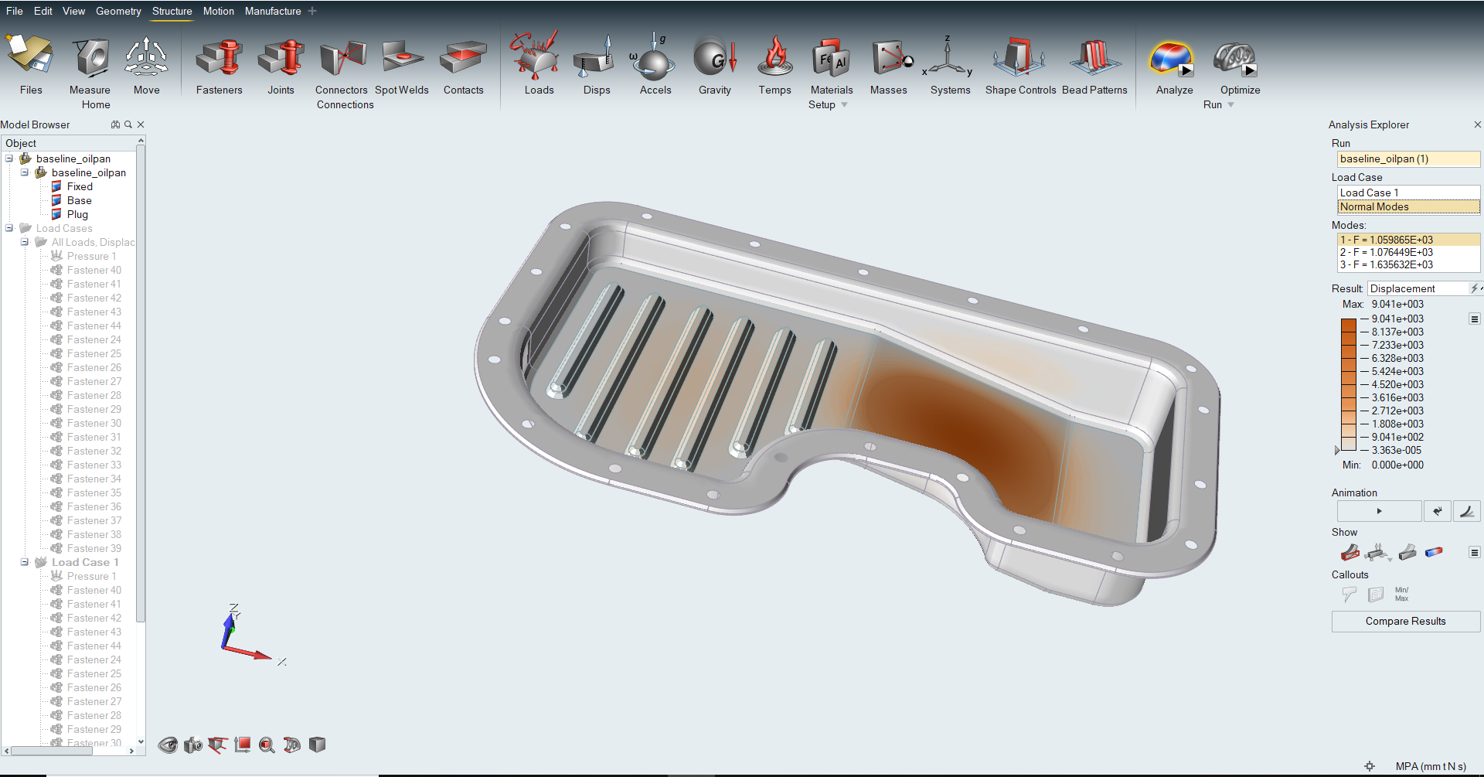
Before

Slide 4
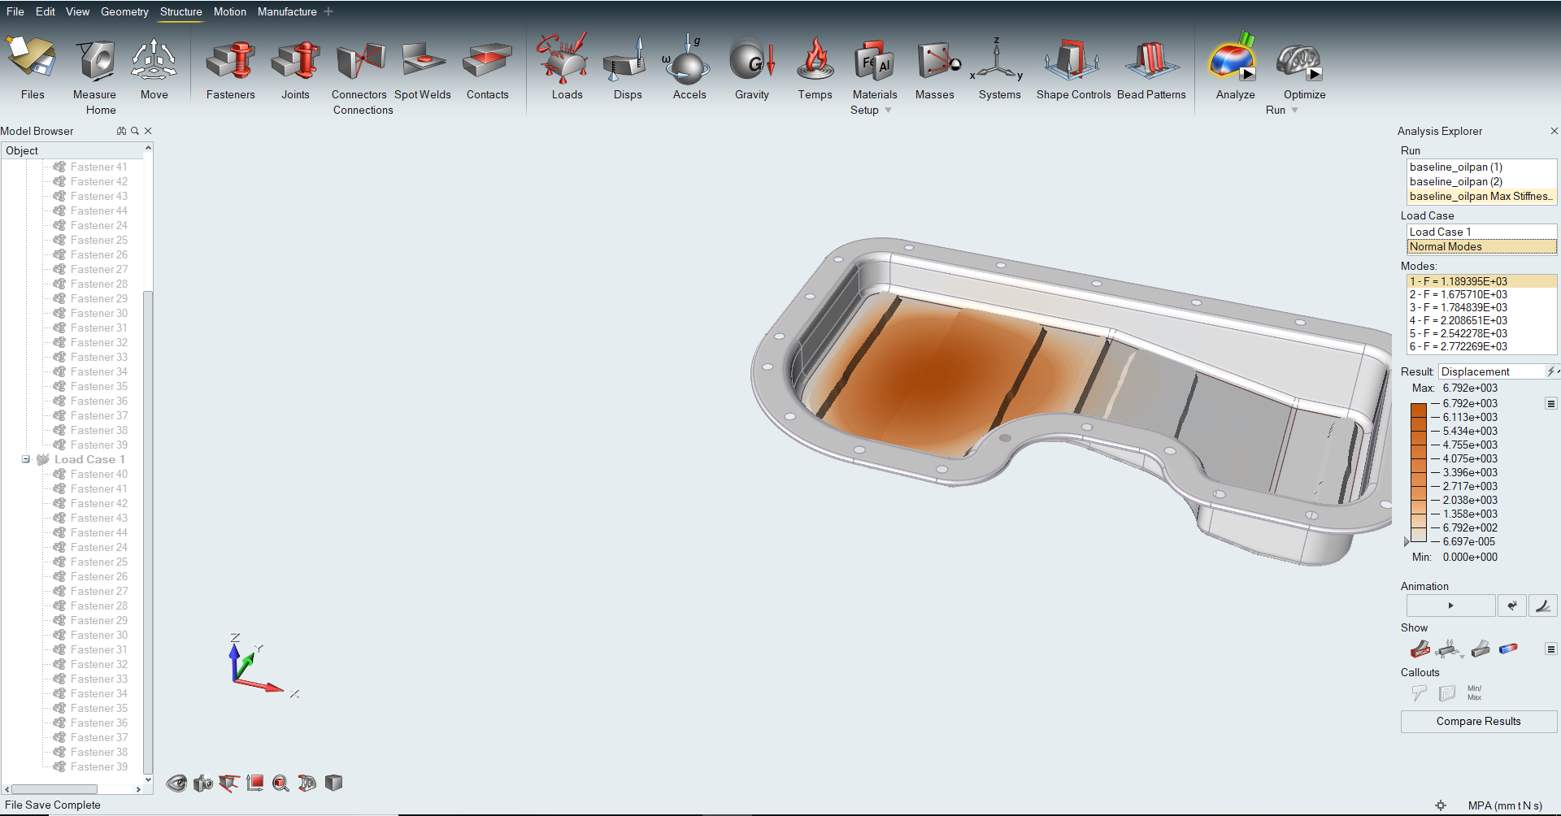
After

Slide 5
Results
Lower mass is achieved without sacrificing stiffness or safety.
This can lead to a higher performing vehicle since it weights less. Higher fuel economy is achieved as well as performance

